Slide 1
Maynooth Pottery
Annual Report

Slide 2
Sales Staff
Area Covered:
  North
    Ed Delaney
    Frank Mullins
  South
    Luisa Garcia
    Kevin Byrne
Area Covered:
  East
    Jenny Grogan
    Akono Conteh
  West
    David Phelan
    Justine Kelly
Notes:
Congratulate Sales Team on increased sales
Recognise special achievement by Akono Conteh

Slide 3
Sales Results
 | Qtr1 | Qtr2 | Qtr3 | Qtr4
North | 12,020 | 13,476 | 14,985 | 18,568
South | 10,340 | 11,435 | 12,680 | 14,220
East | 14,340 | 15,235 | 16,985 | 20,125
West | 11,700 | 10,350 | 12,455 | 14,500

Slide 4
Sales Results

Slide 5
Results from Previous Year

Slide 6
Top Selling Products
Craft
Seasonal
Standard Tableware
Notes:
Suggestions for new products welcome

Slide 7
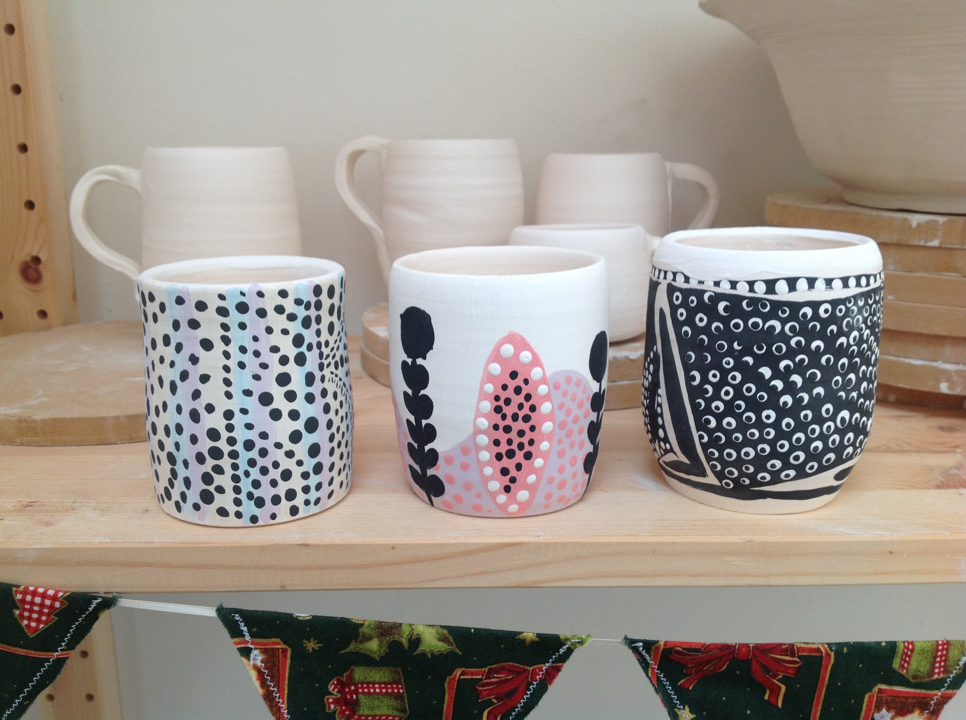
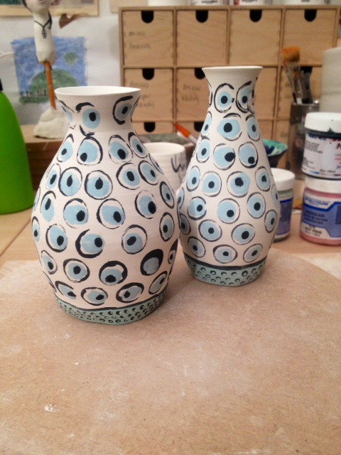
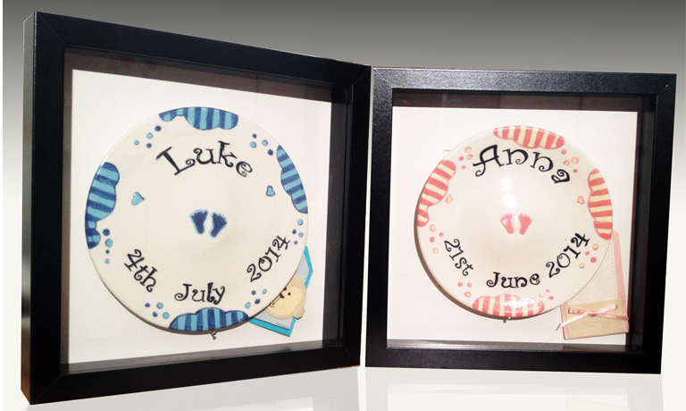
New Range by Lead Potter: Aine Healy
Notes:
Excellent job on latest products

Slide 8
Initiation
Requirements
Documentation
Design
Board Approval
Reject
Production
End

